Slide 1
Importing DataSets

Slide 2
Learning Objectives
Identify three types of Python libraries and describe their uses
Demonstrate how to import and export data in Python
Analyze Python data using a dataset
Access databases using Python database APIs

Slide 3
Introduction
Using Python we are going to use analyze data
Numpy, Pandas, SciKit learn (Klearn) libraries are used to analyze data
These python libraries are integral to becoming a data scientist and are used in industries such as Healthcare, Finance, Insurance, Internet etc.,

Slide 4
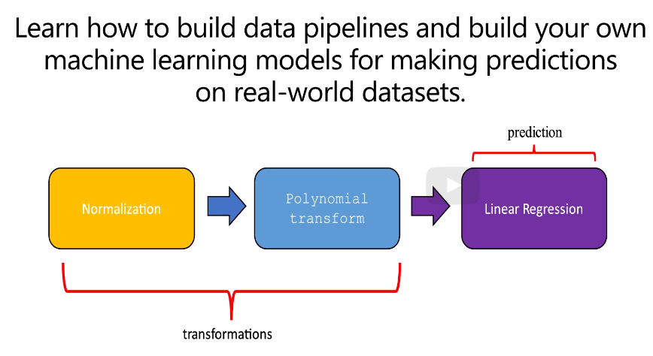

Slide 5
Importing DataSets
Learn how to understand dataset characteristics
Get an overview of Python Packages for analyzing the data
Learn how to import data and start analyzing it.

Slide 6
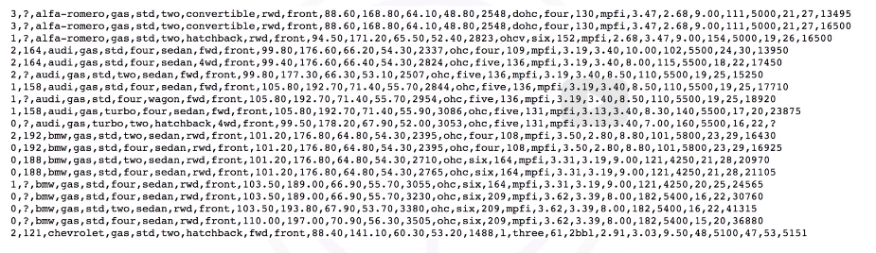
Understanding the Data
Dataset used for automobiles

Slide 7
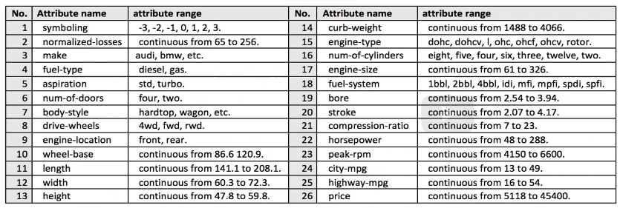
Each of the attributes in the dataset

Slide 8
Symboling: corresponds to the insurance risk level of the car
Normalized losses: The relative average loss payment per insured vehicle year
Price: Target value or label i.e., the value that we want to predict from the dataset and the predictors should be all the other variables listed

Slide 9
Python Packages for Data Science
A python library is a collection of functions and methods that allow you to perform lots of actions without writing any code
The libraries usually contain built-in modules providing different functionalities which we can use directly
We have divided the python data analysis libraries into three groups
Scientific Computing Libraries
Visualization Libraries
Algorithmic Libraries

Slide 10
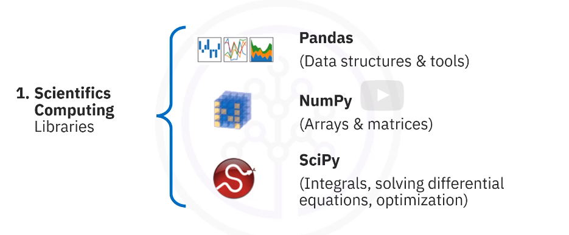

Slide 11
Scientific Computing Libraries
Pandas offers data structure and tools for effective data manipulation and analysis.
It provides fast access to structured data.
The primary instrument of Pandas is a two dimensional table consisting of column and row labels, which are called a data frame.
It is designed to provide easy indexing functionality.
NumPy library uses arrays for its inputs and outputs.
It can be extended to objects for matrices, and with minor coding changes, developers can perform fast array processing.
SciPy includes functions for
some advanced math problems as listed on this slide, as well as data visualization.

Slide 12
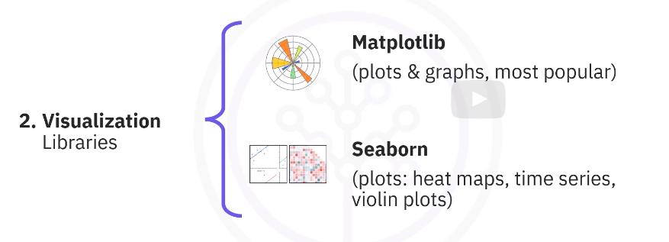

Slide 13
Visualization Libraries
Using data visualization methods is the best way to communicate with others, showing the meaningful results of analysis.
These libraries enable you to create graphs, charts, and maps.
The Matplotlib lib package is the most well-known library for data visualization.
- It is great for making graphs and plots.
- The graphs are also highly customizable.
Another high-level visualization library is Seaborn.
- It is based on Matplotlib.
- It's very easy to generate various plots such as heat maps, time series, and violin plots.

Slide 14
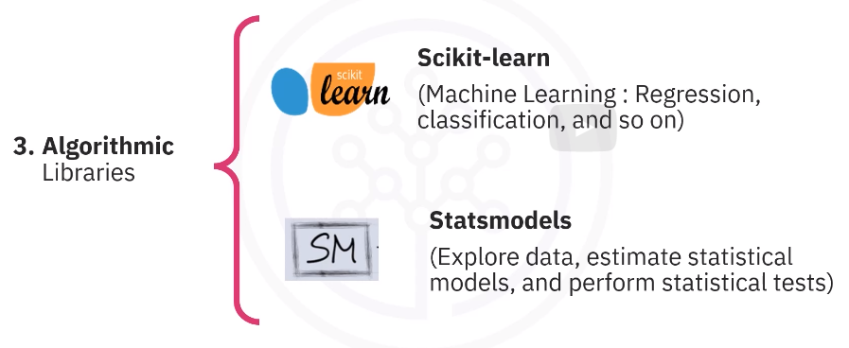

Slide 15
Algorithmic Libraries
With machine learning algorithms, we're able to develop a model using our data set and obtain predictions.
The algorithmic libraries tackle some machine learning tasks from basic too complex.
The Scikit-learn library contains tools, for statistical modeling, including regression, classification, clustering, and so on.
This library is built on NumPy, SciPy, and Matplotlib.
2. Statsmodels is also a Python module that allows users to explore data, estimate statistical models, and perform statistical tests.

Slide 16
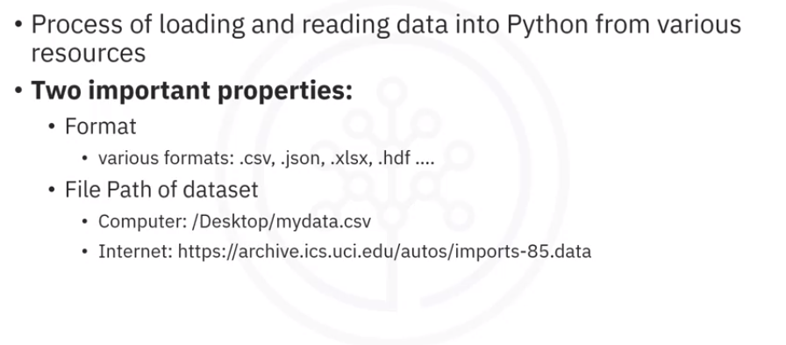
Importing Data in Python
Data can be read by using Pandas package.

Slide 17
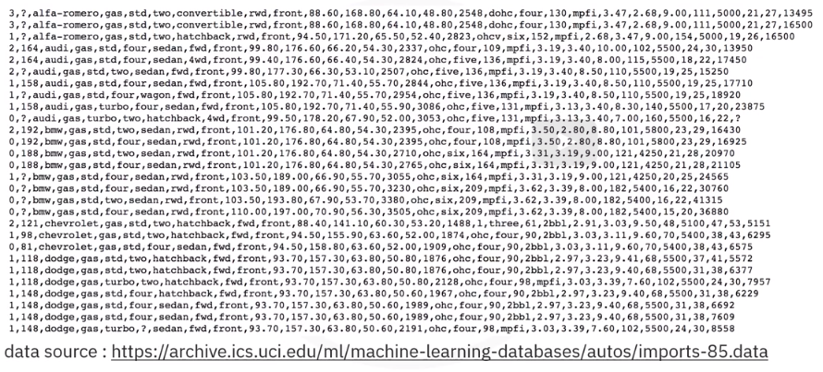
Getting Data

Slide 18
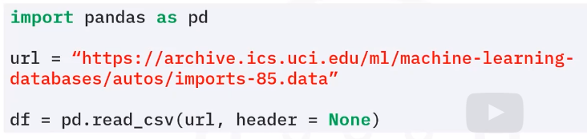
Importing a CSV into Python
In Pandas, the read_csv method can read in files with columns separated by commas into a Pandas data frame.
Reading data in Pandas can be done quickly in three lines.
First, import Pandas, then define a variable with a file path.
And then use the read_csv method to import the data.
However, read_csv assumes the data contains a header.
Our data on used cars has no column headers.
So we need to specify read_csv to not assign headers by setting header to none.

Slide 19
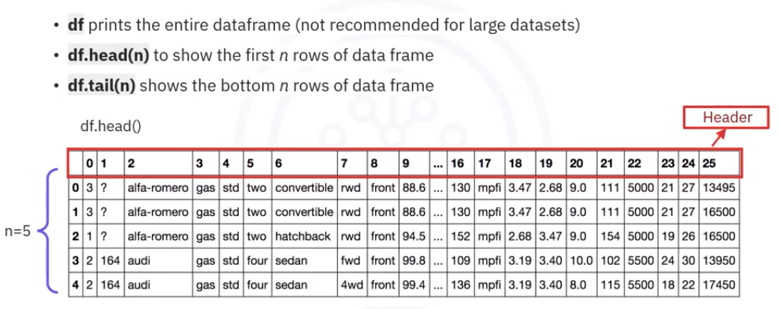
Printing the Data Frame in Python

Slide 20
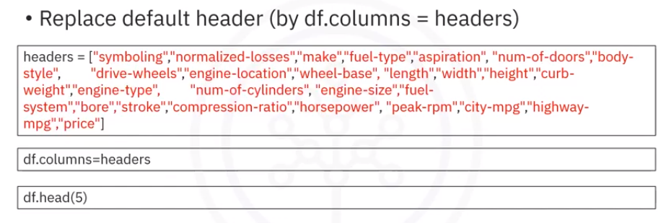
Adding Headers

Slide 21
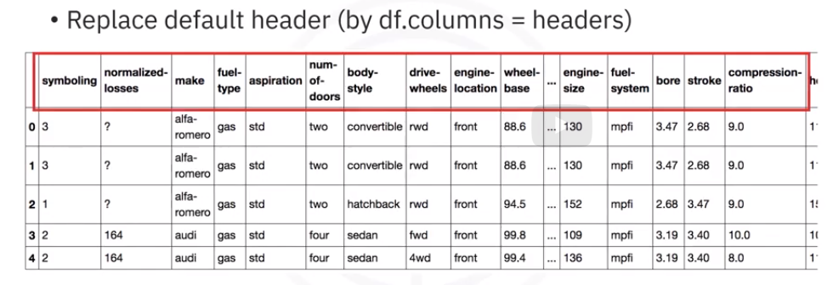
Adding Headers

Slide 22
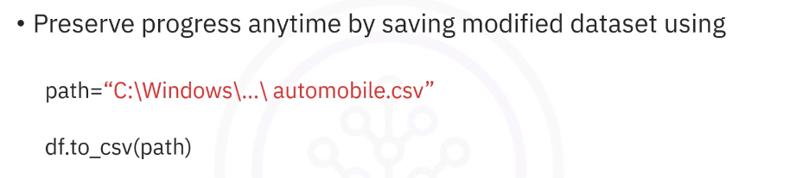
Exporting a Pandas data frame to CSV

Slide 23
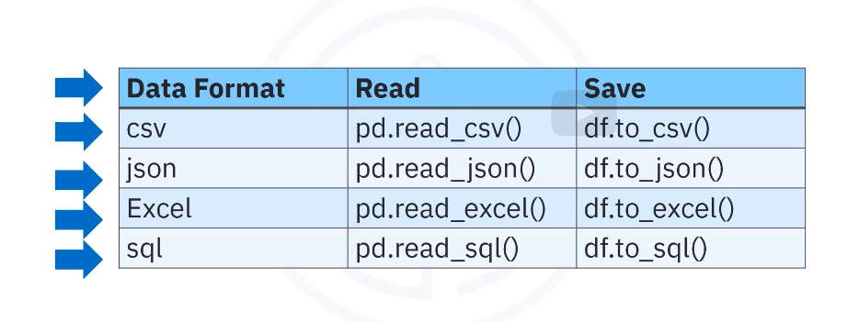
Exporting to different formats in Python

Slide 24
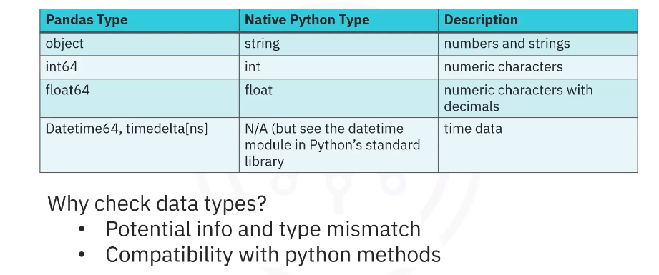
Basic Insights form the data: Data types

Slide 25
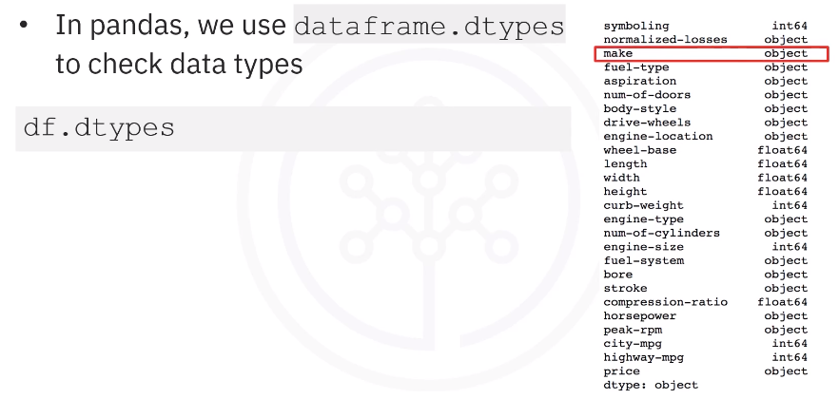
Basic Insights form the data: Data types

Slide 26
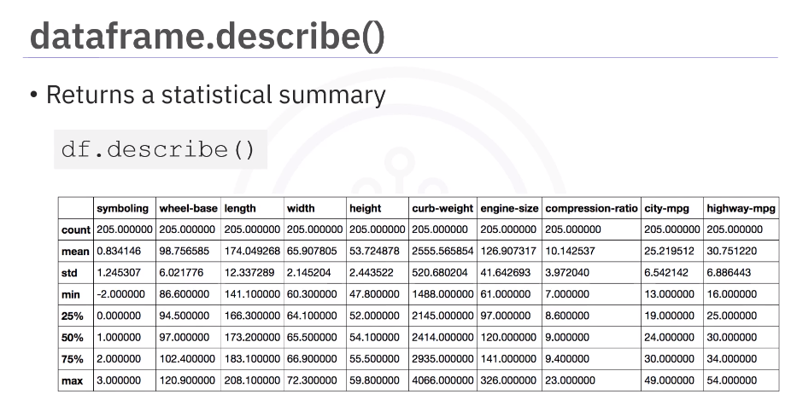

Slide 27
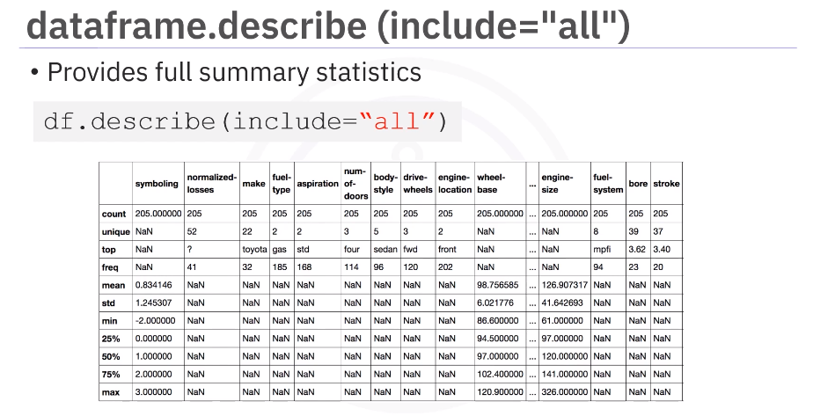

Slide 28
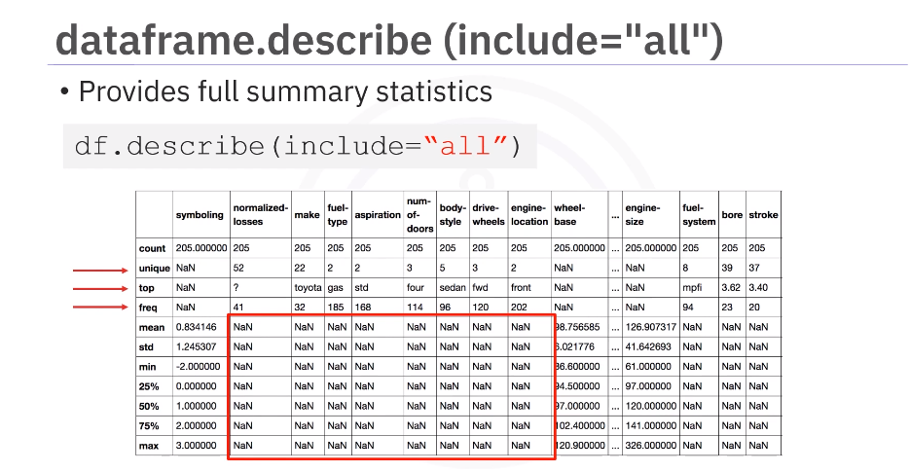

Slide 29
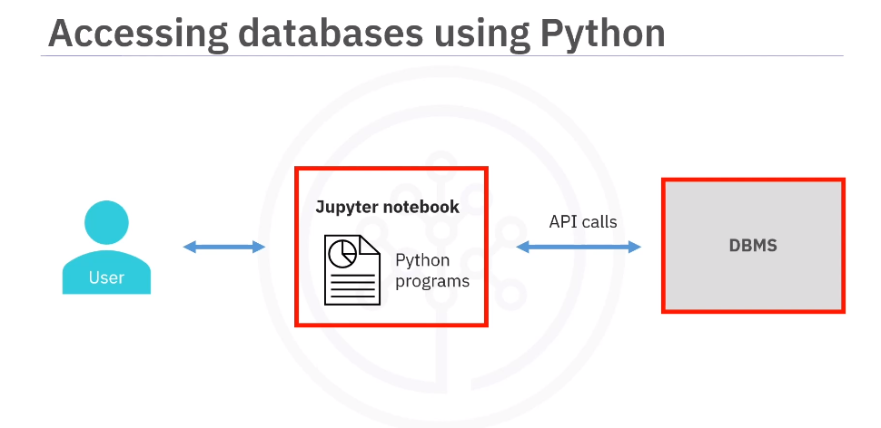

Slide 30
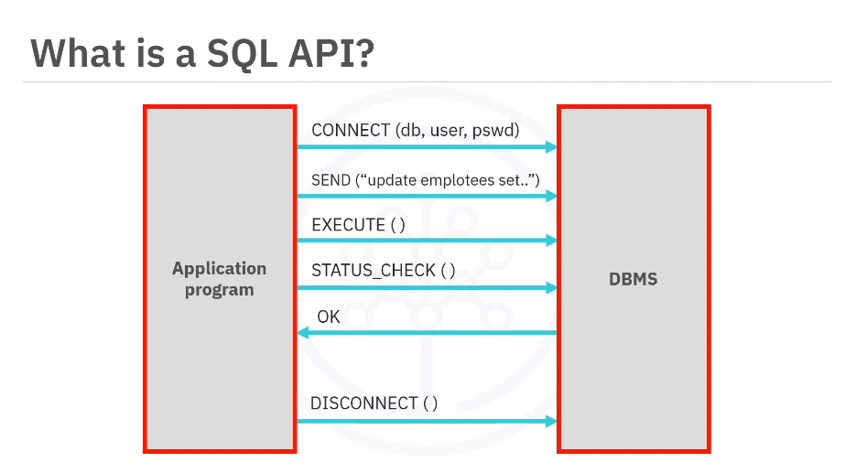

Slide 31
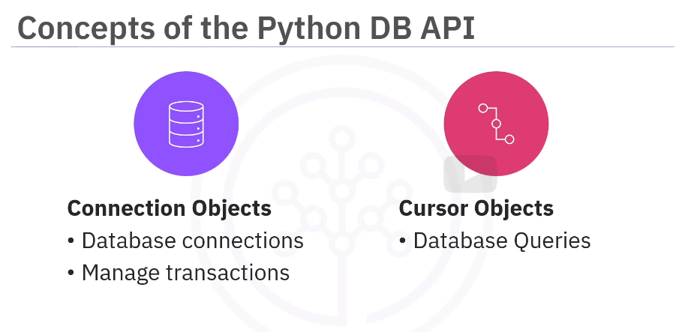

Slide 32
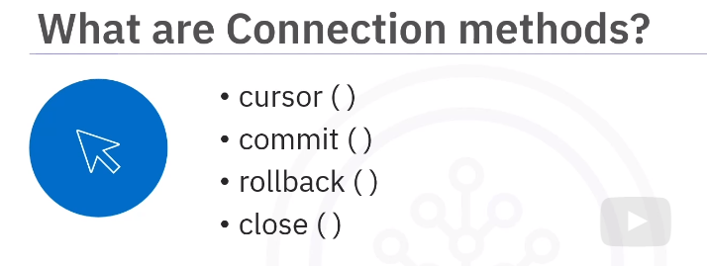

Slide 33
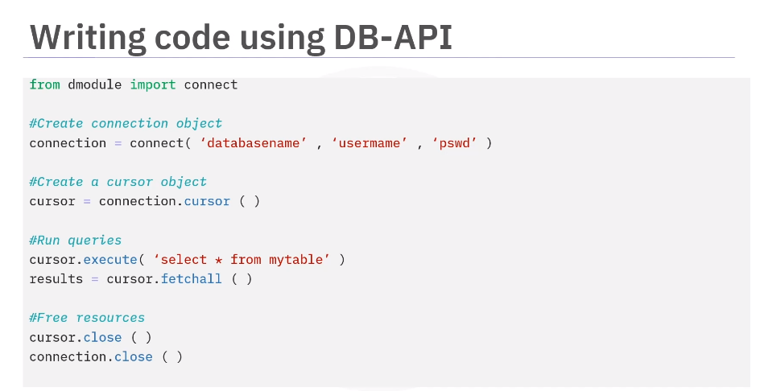

Slide 34
Thank You

